Slide 1
Image Filtering
Multistage Median Filter
The multistage median filter is a variation of the standard median filter that is able to retain image details for large windows, where the standard median filter would start degrading the quality of these features.
It uses four subfilters that are sensitive to horizontal, vertical, and diagonal directions.
For this exercise, you are tasked to perform multistage median filtering on an image that has been corrupted with noise.

Slide 2
Image Filtering
Multistage Median Filter
The algorithm takes as input a noise image and the size of the multistage median filter window and applies multistage median filtering to the image by splitting each window into four sub-windows and finding their respective median values. Then, it changes the value of the current center pixel with the median value among that pixel and the four medians that were found. It uses 0-padding in order to avoid the creation of black borders in the image.
Finally, it returns the filtered image which is displayed alongside the noise one.

Slide 3


Image Filtering
Multistage Median Filter
Intermediate output example of a $7×7$ multistage median filter on an image corrupted by salt and pepper noise.
Input example.

Slide 4
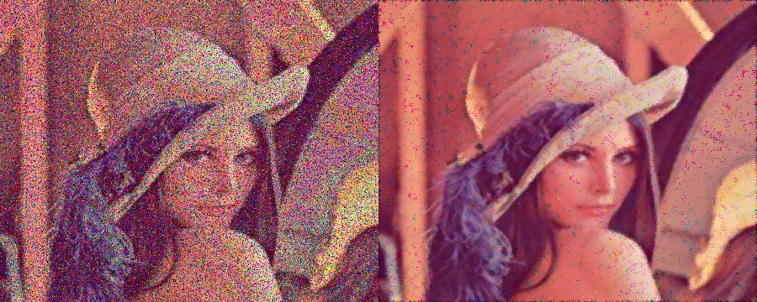
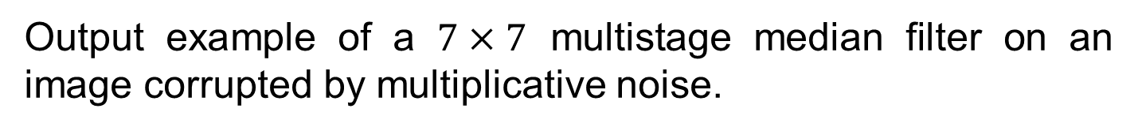
Image Filtering
Multistage Median Filter
Output example of a $7×7$ multistage median filter on an image corrupted by multiplicative noise.

